Slide 1

ENGINEERING CHEMISTRY
Lata Pasupulety
Department of Science and Humanities

Slide 2

ENGINEERING CHEMISTRY
Module 4- Electrochemical equilibria
Class content:
Reference electrodes
Primary reference electrode
Standard Hydrogen electrode
Secondary reference electrodes
Calomel electrode
Silver – silver chloride electrode

Slide 3
ENGINEERING CHEMISTRY
Module 4- Electrochemical equilibria
Reference electrodes
Electrodes whose potentials are accurately known, stable and with reference to which the electrode potential of any electrode can be measured
Reference electrode is combined with indicator electrode and emf of the cell is measured
Two types of reference electrodes:
Primary reference electrodes
Standard Hydrogen electrode(SHE)
Secondary reference electrodes
Calomel electrode
Silver-silver chloride electrode

Slide 4
ENGINEERING CHEMISTRY
Module 4- Electrochemical equilibria
Primary reference electrode: Standard hydrogen electrode
Electrode potential is assigned a value of 0.0 V
Gas electrode
Pt/H₂/H⁺
2H⁺ + 2e⁻ ⇌ H₂
Used to measure potential of other electrodes
e.g.,
Zn/Zn²⁺//H⁺(1M)/H₂(1atm),Pt
E_{cell} = E_{rhs} – E_{lhs} = E_{cathode} – E _{anode}
0.76 = 0.0 – E _{Zn/Zn}²⁺
E _{Zn/Zn}²⁺ = - 0.76 V
Pt ,H₂(1atm) / H⁺(1M)// Cu²⁺/ Cu
E_{cell} = E_{rhs} – E_{lhs} = E_{cathode} – E _{anode}
0.34 = E _{Cu/Cu}²⁺ - 0.0
E _{Cu/Cu}²⁺ = 0.34 V

Slide 5
ENGINEERING CHEMISTRY
Module 4- Electrochemical equilibria
Disadvantages of SHE:
Maintaining concentration of H⁺ ions at 1M and pressure of H₂
gas at 1 atm is difficult.
Platinum is highly susceptible to poisoning by different
impurities in gas
It cannot be used with oxidizing and reducing environment
Secondary reference electrodes:
Due to the limitations of standard hydrogen electrode some other electrodes whose electrode potentials are accurately known and remain stable over a long period of time and can be easily assembled. With respect to these electrodes , electrode potentials of other electrodes can be assigned
e.g.,Calomel electrode, silver silver chloride electrode

Slide 6
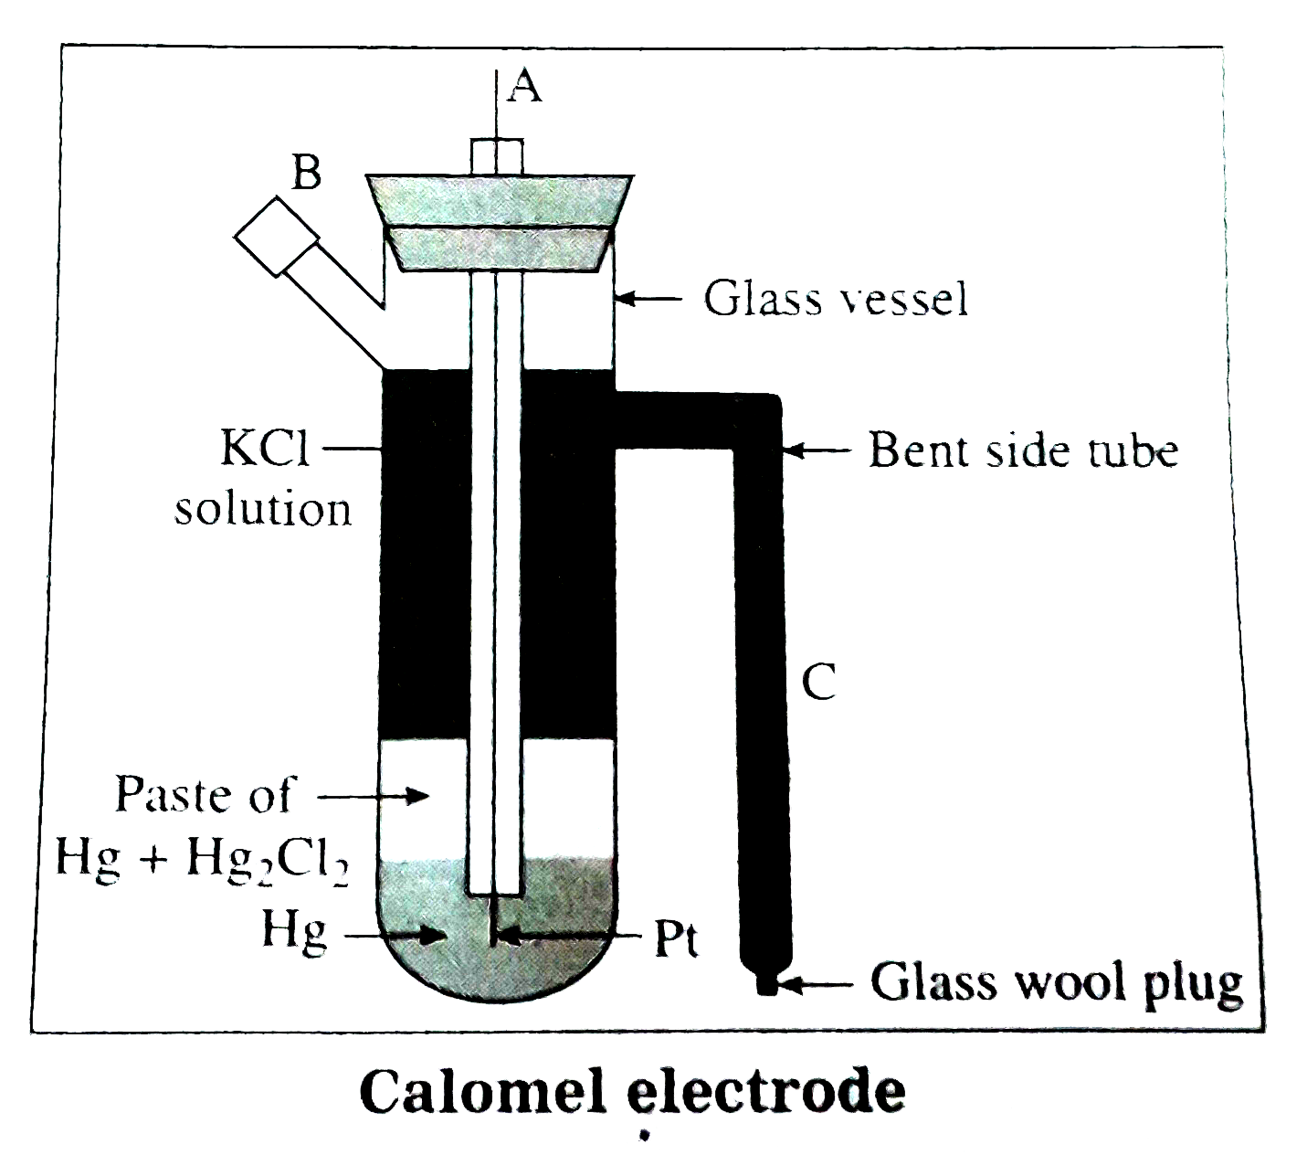
ENGINEERING CHEMISTRY
Module 4- Electrochemical equilibria
Secondary Reference electrodes:
Calomel electrode
Most widely used reference electrode
Metal-insoluble salt –ion electrode
Construction:
A glass tube containing a layer of mercury over which a paste of insoluble salt Hg₂Cl₂ (calomel) + Hg and the next layer is a solution of KCl
A Pt wire dipped in Hg provides electrical contact
Tube is fitted with a side tube to fill KCl solution of known concentration and another side tube which connects to the salt bridge
https://doubtnut.com/question-answer-chemistry/describe-the-construction-and-working-of-the-calomel-electrode-96607395

Slide 7
ENGINEERING CHEMISTRY
Module 4- Electrochemical equilibria
Hg/Hg₂Cl₂(s)/Cl⁻
Working :
Can act as anode or cathode depending on
the nature of the electrode with which it is coupled
As anode:
2Hg ⇌ Hg₂²⁺ + 2e⁻
Hg₂²⁺ + 2 Cl⁻ ⇌ Hg₂Cl₂
2Hg + 2 Cl⁻ ⇌ Hg₂Cl₂ + 2e⁻
As cathode:
Hg₂²⁺ + 2e⁻ ⇌ 2Hg
Hg₂Cl₂ ⇌ Hg₂²⁺ + 2Cl⁻
Hg₂Cl₂ + 2e⁻ ⇌ 2Hg + 2 Cl⁻

Slide 8
ENGINEERING CHEMISTRY
Module 4- Electrochemical equilibria
Applying Nernst’s equation
Hg₂Cl₂ + 2e⁻ ⇌ 2Hg + 2 Cl⁻
E = Eº - 2.303RT/2F log [Cl⁻]²
at 298K
E = Eº - 0.0591 log [Cl⁻]
Electrode is reversible to chloride ions
Electrode potential depends on chloride ion concentration
Types of calomel electrodes:
[KCl] | Name | Electrode potential at 298K
0.1M | Decinormal electrode | 0.3358 V
1M | Normal electrode | 0.2824 V
Saturated solution of KCl | Saturated Calomel Electrode(SCE) | 0.2422 V

Slide 9
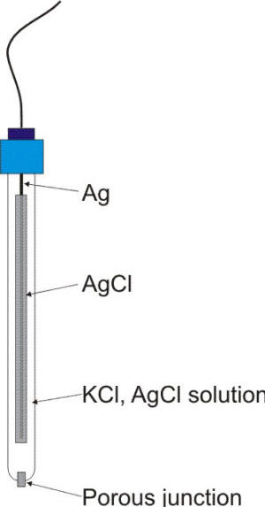
ENGINEERING CHEMISTRY
Module 4- Electrochemical equilibria
Silver-silver chloride electrode
Widely used as reference electrode
Metal-insoluble salt –ion electrode
Construction:
It has a silver wire or a silver coated
platinum wire, coated electrolytically with a
thin layer of silver chloride which is dipped
in a solution of KCl or HCl of known
concentration
Ag/AgCl/Cl⁻
Source:https://www.corrosion-doctors.org/Corrosion-Thermodynamics/Reference-Half-Cells-Silver.htm

Slide 10
ENGINEERING CHEMISTRY
Module 4- Electrochemical equilibria
Working :
Can act as anode or cathode depending on
the nature of the electrode with which it is coupled
As anode:
Ag ⇌ Ag⁺ + e⁻
Ag⁺ + Cl⁻ ⇌ AgCl
Ag + Cl⁻ ⇌ AgCl + e⁻
As cathode:
Ag⁺ + e⁻ ⇌Ag
AgCl ⇌ Ag⁺ + Cl⁻
AgCl + e⁻ ⇌ Ag + Cl⁻

Slide 11
ENGINEERING CHEMISTRY
Module 4- Electrochemical equilibria
Applying Nernst’s equation
AgCl + e⁻ ⇌ Ag + Cl⁻
E = Eº - 2.303RT/F log [Cl⁻]
at 298K
E = Eº - 0.0591 log [Cl⁻]
Electrode is reversible to chloride ions
Electrode potential depends on chloride ion concentration
Types of silver - silver chloride electrodes :
[KCl] | Name | Electrode potential at 298K
0.1N | Decinormal electrode | 0.289 V
1N | Normal electrode | 0.223 V
Saturated solution of KCl | Saturated silver-silver chloride Electrode | 0.199 V

Slide 12
THANK YOU
Lata Pasupulety
Department of Science and Humanities
latapasupulety@pes.edu
+91 80 6666 3333 Extn 759

